Slide 1

COMPUTER NETWORKING
LAB 1

Slide 2
Introduction to Wireshark

Slide 3
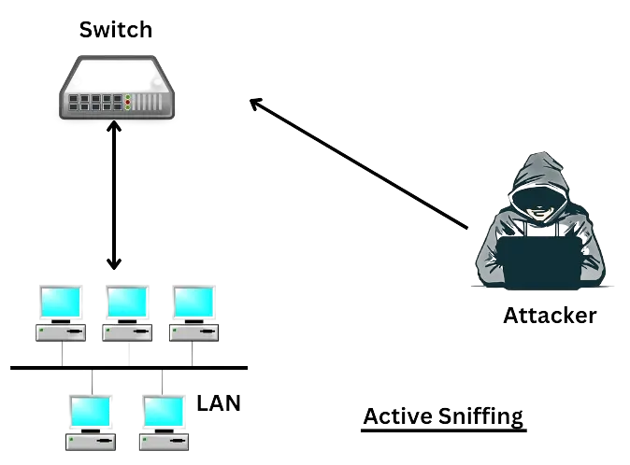
Packet Sniffing
Packet sniffing is a method of tapping each packet as it flows across the network. It is a technique in which a user sniffs data belonging to other users of the network.
Figure 1: Illustration of packet sniffing

Slide 4
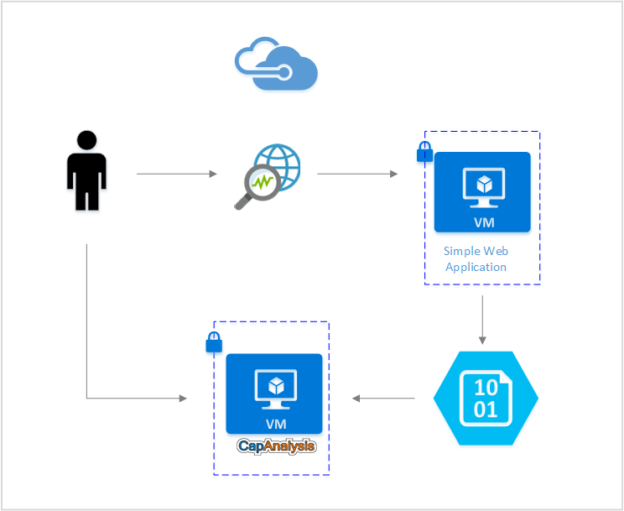
Network Traffic Trace
A recording of the network packets both received by and transmitted from a network interface.
Figure 1: Illustration of network traffic patterns

Slide 5
Wireshark
What is Wireshark?
A graphical network packet analyser.
What some are it's uses?
Is used to analyse network packets.
Troubleshoot network issues
Check for malicious and hacking possibilities.

Slide 6
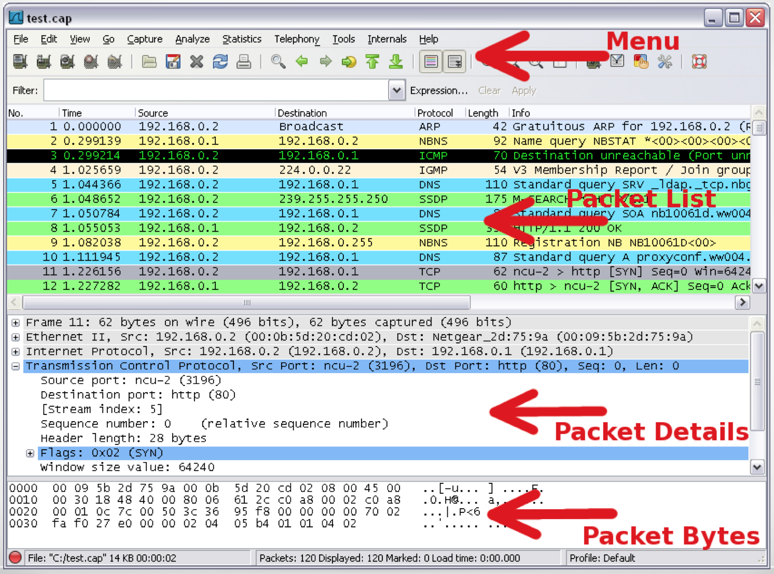
Basic UI

Slide 7
Reference
Patel, Nimisha & Patel, Rajan & Patel, Dhiren. (2009). Packet Sniffing: Network Wiretapping. IEEE International Advance Computing Conference (IACC 2009) Patiala, India, 6–7 March 2009. 2691-2696.
https://www.wireshark.org/

Slide 8
Thank you

